Slide 1
CSCI 5839: User Centered Design (and Development I)
Shaun Kane
University of Colorado Boulder

Slide 2
Discussion

Slide 3
Discussion (in threes)
Have you ever interacted with something that you hated?
Did it ever improve?
How do you think it got better?
How could it have gotten better?
Talk to your neighbors for 5 minutes, then we will share stories as we introduce ourselves.

Slide 4
Themes
What was bad?
Ugly
Mistakes costly
Didn’t map your expectations
Not built for really obvious human needs
Design doesn’t match actual use
How did things improve?
Reduce steps / amount of work
More convenient

Slide 5
(very) brief introductions

Slide 6
About you
Who is new to CU?
Who is from computer science?
Everybody else?
Who is new to design?
Who is nervous about the class?

Slide 7
Teaching staff
Instructor: Shaun Kane http://shaunkane.info
TAs
David Quigley
Gena Welk

Slide 8
User-Centered Design

Slide 9
About this course
Focus on learning about and practicing methods for conducting user-centered research and design
Brainstorming
User research
Sketching and prototyping
User testing and analysis
Mostly about skills rather than about facts

Slide 10
What you will learn
Design and Engineering
design processes
user interface toolkits
building useful and usable things!
Science
conduct usability evaluations
empirical methods, how to handle data
use data in design
Art
an eye for the good, the bad, and the not so good
what to do about them
Technology: as a means to an end

Slide 11
End goals
Gain expertise in applying methods of user centered design
What’s it good for?

Slide 12
End goals
Gain expertise in applying methods of user centered design
What’s it good for?
Make things that work better for people
Understand why things are bad and how to fix them
Create new things that meet what users want and need

Slide 13
Why learning this is important
You will likely find yourself involved in the creation of an interactive system, and will want to do it well
You will be working with people with different training than you and need to understand their processes
Integrating design, research, and evaluation key to many careers in computing

Slide 14
What we won’t do
Develop complete and working systems (but may create opportunities for future research or independent studies)
Spend much class time on UI programming specifically
Get deep into data analysis or statistics

Slide 15
How we’ll spend time in this class
Often we will follow a “flipped” classroom model: reading at home and work in class
Typical class pattern
Read about design methods and add questions/comments on Piazza
Q&A in class
Practice methods during class time
Use methods on real-world design projects for assignment

Slide 16
What you’ll need
Official CU email address
Piazza.com account
Students should own, and bring to class every day, plain white paper and writing/drawing implements of your choice. You should bring pens and pencils in at least 3 colors.
No textbook

Slide 17
Technology in the classroom
Not required; use what you need
But texting has been linked with reduced understanding and grades [1]
If it’s distracting, we’ll need to revisit policy
[1] http://assett.colorado.edu/distracted-by-the-digital-age/

Slide 18
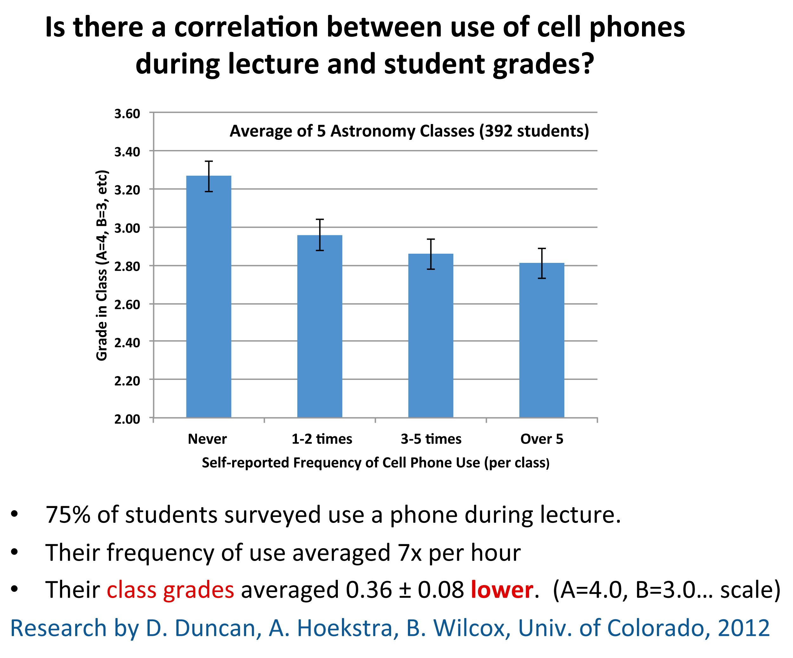

Slide 19
Assignments
Group project (40%)
Individual assignments (35%)
Reading responses (10%)
In-class activities (10%)
Contributions to class learning (5%)
Core skills: writing and presenting clearly, learning to iterate based on feedback
Notes:
More about assignments next time

Slide 20
Group project
Design and test a prototype software application to solve a problem experienced by a specific user population
Generate ideas
Investigate real users (observe, interview)
Sketch and create prototypes
Test your prototypes with users
Iterate, refine, make it better
Document project via prototypes and a video

Slide 21
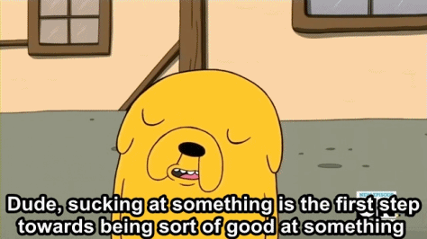
Notes:
Adventure Time! Image from http://24.media.tumblr.com/84ebf7b09a535a7dd568801ee65d6ae8/tumblr_mjx2y7KQCH1s382suo1_500.gif

Slide 22
Examples of previous projects
Location-aware music discovery app
Google Glass app to visualize sound for deaf and hard of hearing people
Smartphone shopping assistant for blind people
Web recipe book for people with complex dietary needs

Slide 23
Individual assignments
Practice user observation and evaluation on your own (or with 1 partner)
Peer feedback for other project groups
3 “sketching” assignments with flexible due dates, to explore new ideas

Slide 24
Class resources
Web site: http://shaunkane.info/classes/csci5839/
Piazza discussion board
Course calendar
No textbooks

Slide 25
Grading
Engineering model meets the humanities model
A is for work that is complete and of high quality
Need to demonstrate that you went through the steps carefully and learned from the process
Iteration explicitly built in to many assignments
You don’t need to be artistically talented or stumble upon a brilliant idea

Slide 26
My expectations of you
Arrive to class on time
Let me know if you will be late or absent
Turn in assignments on time
Let me know 24 hours before deadline if you won’t make it and need a new deadline
Be willing to spend 6 hours a week on this class (outside of lecture)
Cite all collaborators or references clearly

Slide 27
What you can expect from me
Office hours: Thursday 1-1:45pm, DLC 173A
Respond to questions within 24 hours
I check email/Piazza in the evening
Graded assignments within 1 week
Post slides within 24 hours after class

Slide 28
How to get an A
Show up, participate, help other project groups
Do all the assignments: write clearly, show that you went through the process and learned something
Turn in professional-looking work on time
Don’t turn in first drafts
Try to find ways to be engaged in the work

Slide 29
For next time
Read the syllabus on the course web page (questions/comments on Piazza)
Read Chapters 1 & 2 of “Don’t Make Me Think” (15-20 minutes)
Sign up for Piazza and leave a (brief) comment on the reading (5 minutes)
A0: Put together 2 introductory slides for Thursday’s class (10-20 minutes)
Start thinking about project ideas

Slide 30

Reading
Introduction to user-centered design thinking
Quick and accessible read
Please read and comment (but OK if it is later in the week)
Notes:
Image: amazon.com

Slide 31
Questions?

Slide 32
Introduction to HCI and Design

Slide 33
Vocabulary fun
Lots of new terms
HCI
HCC
Design
User-centered design

Slide 34
What is HCI? (or HCC)
Human computer interaction?

Slide 35
What is HCI?
“Design, evaluation and implementation of interactive computing systems for human use and the study of the major phenomena surrounding them.”
–Special Interest Group on Human-Computer Interaction (SIGCHI) of the Association for Computing Machinery (ACM)

Slide 36
Interactive computing system?

Slide 37
Interactive computing systems
Single PC - capable of displaying web pages
Embedded devices, for example in cars and in cell phones
Handheld Global Positioning Systems for outdoor activities
Software that allows collaboration

Slide 38
HCI is Interdisciplinary
Behavioral Science
Design
HCI
Computer Science
Notes:
Mix of three disciplines

Slide 39
HCI is Interdisciplinary
Interdisciplinary and eclectic, building on a dozen different disciplines…

Slide 40
Fields that HCI builds on
Computer Science
Implementation of website or other interface
Engineering
Faster, cheaper equipment
Ergonomics
Design for human factors
Graphic design
Visual communication
Technical writing
Textual communication

Slide 41
Fields that HCI builds on, continued
Linguistics, artificial intelligence
Speech recognition, natural language processing
Cognitive psychology
Perception, memory, mental models
Sociology
How people interact in groups
Anthropology
Study of people in their work settings
HCI is for misfits
Notes:
The challenge: students—and instructors—may feel that they have to learn graphic design and cognitive psychology to do HCI. Except for the students who know something about these fields—this can be intimidating.
The satisfaction: anybody can learn a lot about HCI without any formal background in much of anything.
Plus: some people find the combination fun.

Slide 42
What skills does an HCI expert have?

Slide 43
Design

Slide 44
What is design?
Practical, aesthetic considerations
Usability – how well, how efficiently it works
Understanding audience
Solving a Problem

Slide 45
Is design art?

Slide 46
Design IS art…
Design IS NOT art…

Slide 47
Is design subjective?

Slide 48
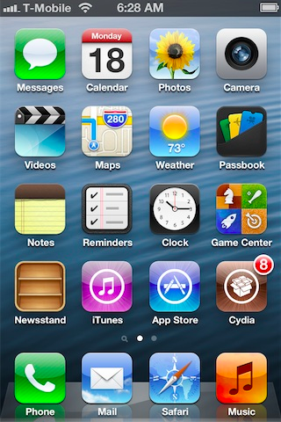
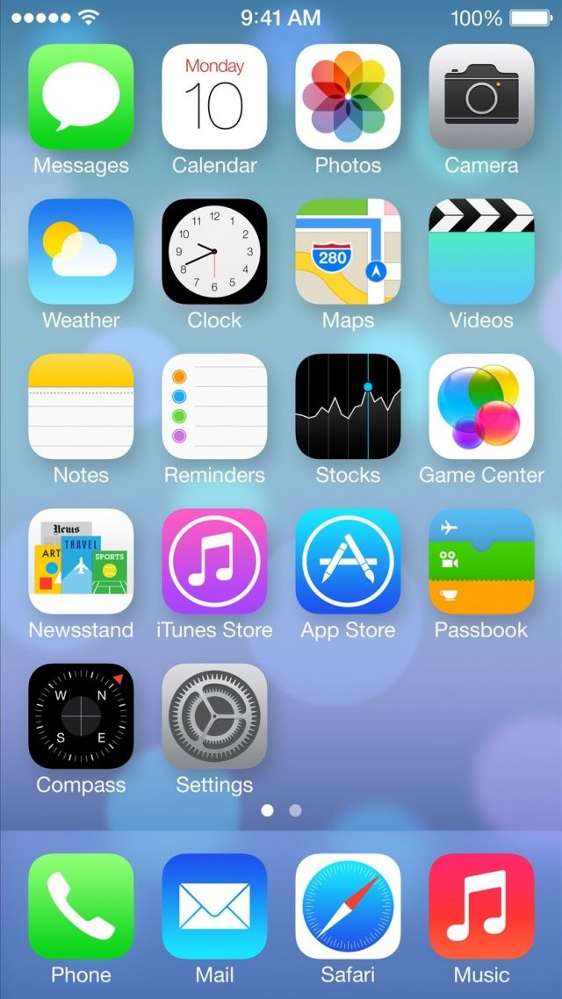

Slide 49
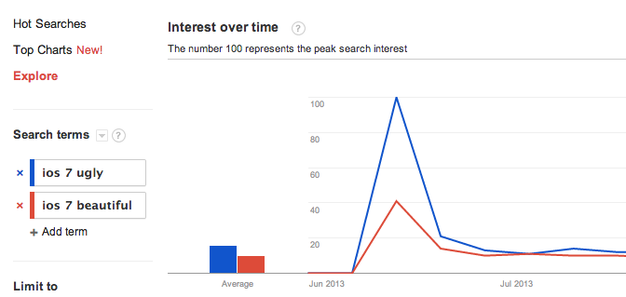
Is design subjective?
http://www.google.com/trends/

Slide 50
Is design SCIENCE?

Slide 51
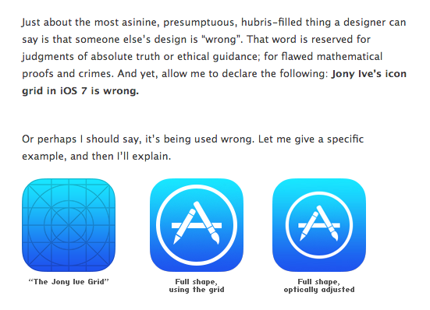
Is design SCIENCE?
http://mrgan.tumblr.com/post/53308781143/wrong

Slide 52
Balancing science and intuition
Use known facts about human cognition, perception, ability
e.g., rule of thirds, 7 ± 2
Use empirical methods to test hypotheses, evaluate, and iterate
Design is not magic

Slide 53
Who are designers?

Slide 54
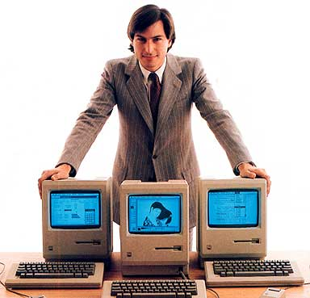
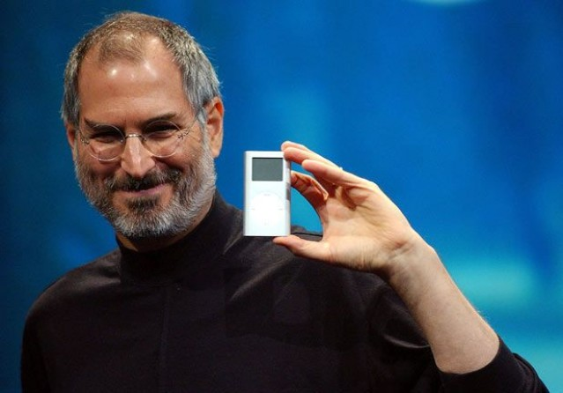
Quotes on design
“Design is not just what it looks like and feels like. Design is how it works.”
- Steve Jobs

Slide 55
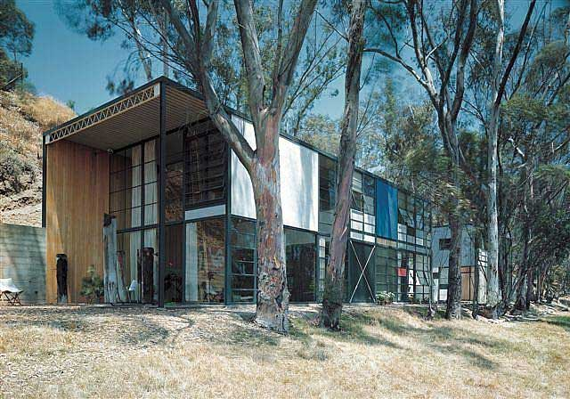
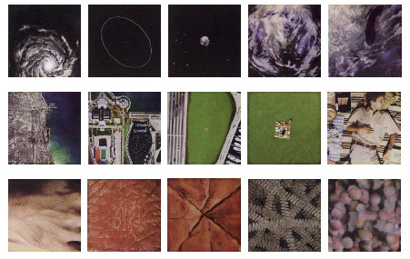
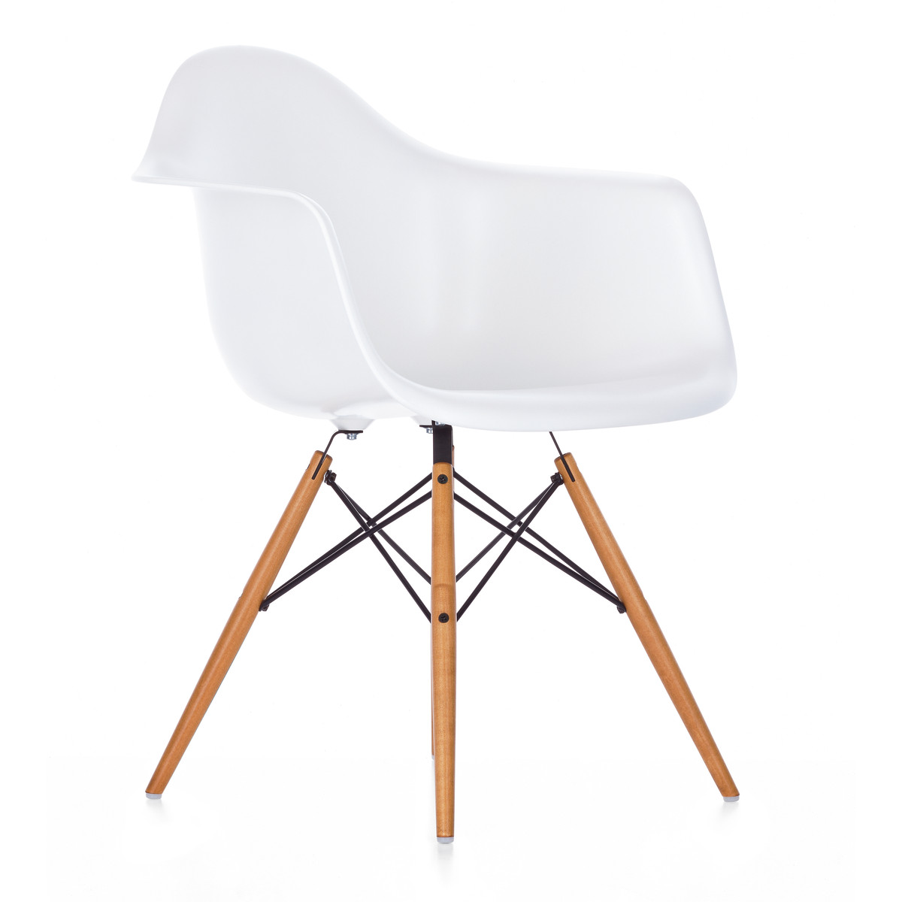
Quotes on design
“Design is a plan for arranging elements in such a way as best to accomplish a particular purpose.” – Charles Eames

Slide 56
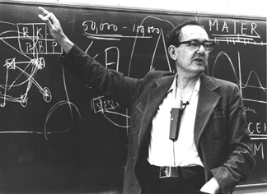
Quotes on design
“Engineering, medicine, business, architecture and painting are concerned not with the necessary but with the contingent - not with how things are but with how they might be - in short, with design.” – Herb Simon

Slide 57
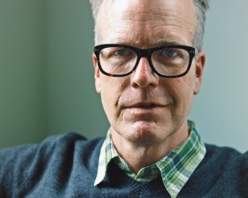
Quotes on design
“I’ve been amazed at how often those outside the discipline of design assume that what designers do is decoration—likely because so much bad design simply is decoration. Good design isn’t. Good design is problem solving.”
- Jeffrey Veen, The Art and Science of Web Design

Slide 58
Design process

Slide 59
(One) Design process
Make something
Done!

Slide 60
How do we know what to build?
requirements, users’ desires
User research
Make
Done!

Slide 61
How do we come up with ideas?
many failed ideas
User research
Ideate
Make
Done!
the best ideas

Slide 62
How do we know if we’re right?
User research
Ideate
Prototype
Evaluate
Done!

Slide 63
Closing the loop
User research
Ideate
Prototype
Evaluate
Done!

Slide 64
Activity: Design in miniature
Let’s come up with a problem
Identify some potential solutions to it
Draw what it might look like
Get feedback

Slide 65
Ideas
Cutting dog treats
Organizing physical stuff
Organizing virtual stuff (movies, storage)
New students
Finding on-campus parking
Navigating on campus
Finding a place to live (requirements)
Finding stuff in the store

Slide 66
Navigating on campus
Buildings look the same
Numbering of floors, buildings
No labeling
Construction – things are changing
Connectivity can be poor
Navigating/orientation: cardinal directions, landmarks

Slide 67
Solutions
Instrumenting buildings
Signs on buildings
Numbering strategy
Labels within the space
Guidance system w/voice
Visual design different

Slide 68
Apps/mobile technology
Really precise GPS/guidance
Proximity tags vs. clickers
Augmented reality: look labels
Google Glass
Barcodes on the walls (“hobo signs”)
Segway/tram/robot shoes
Hover shoes
Smartwatch
Robotic guides

Slide 69
My problem
Where to eat dinner?

Slide 70
User research

Slide 71
Ideate
In groups of 3
Come up with 3 ideas

Slide 72
Share ideas

Slide 73
Combine, refine, remix

Slide 74
Test

